Slide 1
SQL Review
Lecture 01

Slide 2
Agenda
SELECT
DML
DDL
JOIN

Slide 3
SELECT
Fetch Data from a Database

Slide 4
SQL Statements
Data Manipulation Language (DML) | SELECT INSERT UPDATE DELETE
Data Definition Language (DDL) | CREATE ALTER DROP RENAME
Data Control Language (DCL) | GRANT REVOKE
Transaction Control Language (TCL) | COMMIT ROLLBACK SAVEPOINT

Slide 5
Select
SELECT: identifies the columns or calculations
FROM: identifies the table that you want to retrieve data from
WHERE: identifies the condition that has to be met for the record to be selected.
SELECT [distinct]
column1,
column2,
[expression]
...
FROM
tablename
[WHERE conditions];

Slide 6
Select
SELECT customer_id, name, address
FROM customers;
The above query shows actor_id, first_name, and last_name for all actors in table actor.
SELECT customer_id, name, address
FROM customers
WHERE name = ‘Exelon’;
The above query shows actor_id, first_name, and last_name for actors in table actor whose first_name is NICK.
SELECT * -- selecting all columns
FROM customers;

Slide 7
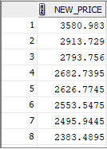
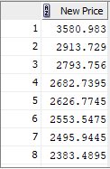
Column Alias
SELECT list_price * 1.05 as new_price
FROM products;
SELECT list_price * 1.05 as "New Price"
FROM products;
…
…

Slide 8
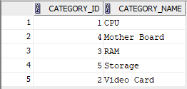
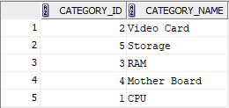
SORTING
ORDER BY column_1[,column_2,…]
Is used to sort the result of a SQL select statement.
The default order is ascending.
SELECT *
FROM ass_product_categories
ORDER BY category_name;
Sorting in Descending Order
Use keyword DESC in the ORDER BY clause
SELECT *
FROM ass_product_categories
ORDER BY category_name DESC;

Slide 9
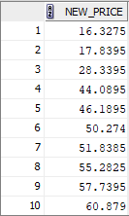
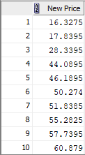
Sorting By Column Alias
The result of a SQL statement can be sorted by a column alias.
SELECT list_price * 1.05 as new_price
FROM ass_products
ORDER BY new_price;
SELECT list_price * 1.05 as "New Price"
FROM ass_products
ORDER BY "New Price";

Slide 10
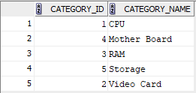
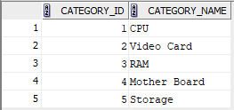
Sorting By Column Numeric Position
SELECT *
FROM ass_product_categories
ORDER BY 2;
The result of the above query is sorted based on the value of the second column.
SELECT *
FROM ass_product_categories
ORDER BY 1;
The result of the above query is sorted based on the value of the first column.

Slide 11
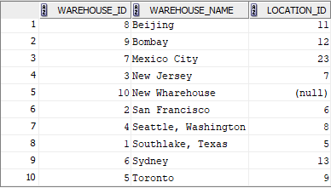
Sorting By Multiple Columns
SELECT *
FROM ass_warehouses
ORDER BY warehouse_name, location_id DESC;
The result of the above query is sorted first by column warehouse_name ascendingly and then by column location_id descendingly.

Slide 12
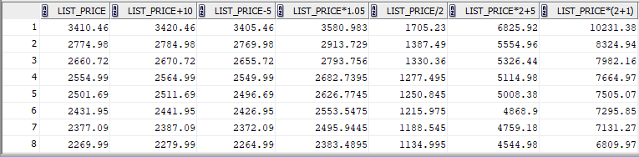
Simple Arithmetic Expressions
Operator | Description | Example
+ | Add | SELECT list_price + 10 FROM products;
- | Subtract | SELECT list_price - 5 FROM products;
* | Multiply | SELECT list_price * 1.05 FROM products;
/ | Divide | SELECT list_price / 2 FROM products;
…

Slide 13
Operator Precedence
* / | Multiplication, division
+ - | Addition, subtraction

Slide 14
Comparison Operators and Conditions
Operator | Description
= | Equal to
> | Greater than
< | Less than
>= | Greater than or equal to
<= | Less than or equal to
<> (!=) | Not equal to
LIKE / NOT LIKE | Match a character pattern
BETWEEN / NOT BETWEEN | Checks values within a given range (inclusive)
IN / NOT IN | Checks multiple distinct values
IS NULL / IS NOT NULL | Checks if a column is null

Slide 15

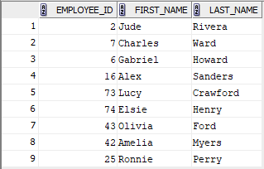
LIKE / NOT LIKE
The “LIKE” operator is used to select a column with a specific string pattern.
The following wild cards is used with the LIKE operator.
%: nothing or anything (zero, one, or more characters)
_: a single character
SELECT employee_id, first_name, last_name
FROM employees
WHERE last_name LIKE '%s%e';
SELECT employee_id, first_name, last_name
FROM employees
WHERE last_name LIKE '%r_';

Slide 16
Escape Character ‘\’
To find the character patterns including ‘_’ (underscore) the escape character ‘\’ is used.
SELECT *
FROM class
WHERE course_code LIKE ‘DBS\_%’
The above condition checks for course_code to starts ‘DBS_’ sub-string followed by zero, one, or more characters.

Slide 17
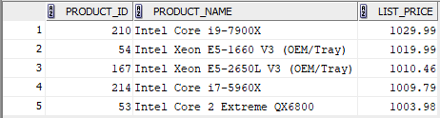
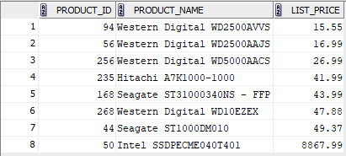
BETWEEN / NOT BETWEEN
SELECT product_id, product_name, list_price
FROM products
WHERE list_price BETWEEN 1000 AND 1050
SELECT product_id, product_name, list_price
FROM products
WHERE list_price NOT BETWEEN 50 AND 8000
ORDER BY list_price;

Slide 18


IN/ NOT IN
SELECT location_id, postal_code, city, state
FROM locations
WHERE city IN ('Munich', 'Toronto', 'Tokyo');
SELECT *
FROM product_categories
WHERE category_id not in (2,3);

Slide 19
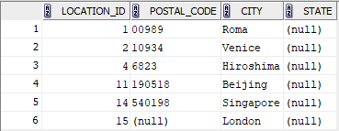
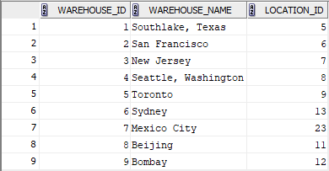
IS NULL / IS NOT NULL
SELECT location_id, postal_code, city, state
FROM locations
WHERE state IS NULL;
SELECT *
FROM warehouses
WHERE location_id IS NOT NULL;

Slide 20
Logical Operators
Operator | Description
NOT | returns true if the condition is false
AND | returns true if all conditions are true
OR | returns true if either condition is true

Slide 21
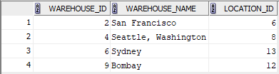
AND / OR
SELECT product_id, product_name, list_price, category_id
FROM ass_products
WHERE category_id = 4 AND list_price < 280;
SELECT *
FROM ass_warehouses
WHERE warehouse_name = 'Bombay' OR location_id IN (6, 8, 13);

Slide 22
Rules of Precedence
Order of precedence | Operator
1 | Parentheses
2 | * /
3 | + -
4 | =, <, >, <=, >=, <>
5 | IS [NOT] NULL, [NOT] LIKE, [NOT] IN
6 | BETWEEN
7 | NOT
8 | AND
9 | OR

Slide 23
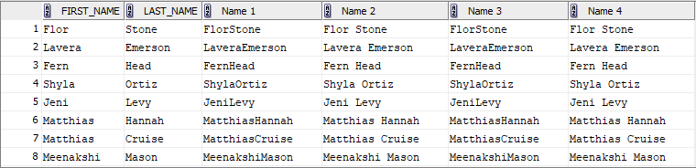
Concatenation Operator
The concatenation operator links columns of type character strings.
Concatenation operator: ||
Concatenation function: CONCAT(column1, column2)
SELECT first_name, last_name,
first_name || last_name as "Name",
first_name || ' ' || last_name as "Full Name“,
CONCAT(first_name,last_name) as "Name 3",
CONCAT(CONCAT(first_name, ' '), last_name) as "Name 3"
FROM contacts;
…

Slide 24
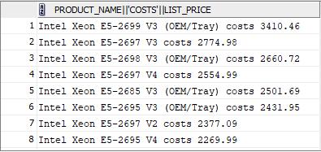
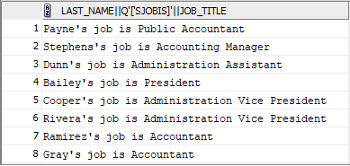
Literal Character Strings
Literals such as a character, a number, or a date can be included in SQL select statement.
Character and date literals must be enclosed by single quotations.
SELECT product_name || ' costs ' || list_price
from products;
…
SELECT last_name || q'['s job title is ]' || job_title
FROM employees;
…

Slide 25
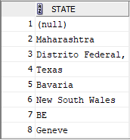
Distinct
Distinct clause is used to remove the duplicate rows from a SQL select query result.
SELECT DISTINCT state
FROM locations;
…

Slide 26
Table Structure
DESC or DESCRIBE
displays a table structure.
DESC products;
or
DESCRIBE products;
Name Null Type
------------- -------- --------------
PRODUCT_ID NOT NULL NUMBER
PRODUCT_NAME NOT NULL VARCHAR2(255)
DESCRIPTION VARCHAR2(2000)
STANDARD_COST NUMBER(9,2)
LIST_PRICE NUMBER(9,2)
CATEGORY_ID NOT NULL NUMBER

Slide 27
DDL
Data Definition Language

Slide 28
DML
Data Manipulation Language

Slide 29
Join
Displaying data from multiple tables

Slide 30
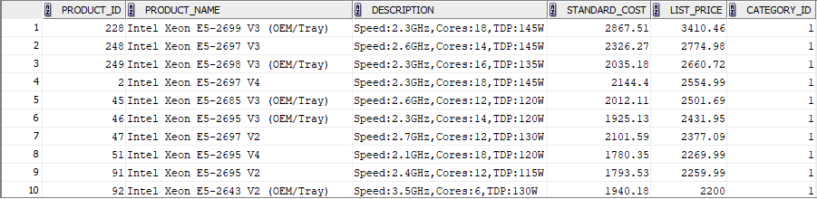
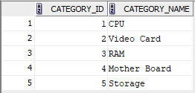
Fetching Data from Multiple Tables
products
product_categories
…

Slide 31
Joins
What is the category name of each product?
To find the category name of each product, we need to select from two tables:
products
product_categories
Different types of joins:
INNER JOIN (JOIN)
LEFT OUTER JOIN (LEFT JOIN)
RIGHT OUTER JOIN (RIGHT JOIN)
FULL OUTER JOIN (FULL JOIN)

Slide 32
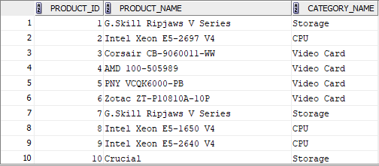
INNER JOIN
INNER JOIN returns all rows from multiple tables if the join condition is true.
SELECT p.product_id, p.product_name, c.category_name
FROM ass_products p
INNER JOIN ass_product_categories c
ON p.category_id = c.category_id
ORDER BY p.product_id;
…

Slide 33

INNER JOIN (Example 2)
What is the category name of products in category 1, 2, and 8.
SELECT p.product_id, p.product_name, c.category_name
FROM ass_products p
INNER JOIN ass_product_categories c
ON p.category_id = c.category_id
WHERE p.product_id in (1,2,8)
ORDER BY p.product_id;

Slide 34
SELF JOIN
Who is the manager of employee with Id 101?
The employee Id is located in table employees.
The manager Id is also located in table employees.
A manager is also an employee. So, the column manager_id in table employees refers to the column employee_id in the same table.
To find the manager name and last name of employee 101, we need to join the employee table with itself:
SELECT e.employee_id, e.first_name, e.last_name, m.manager_id, m.first_name, m.last_name
FROM ass_employees e
INNER JOIN ass_employees m
ON e.manager_id = m.employee_id
WHERE e.employee_id = 101;

Slide 35
OUTER JOINs
Display all customers and their orders. Include the customers without orders in your result.
The INNER JOIN will select all rows from both tables as long as there is a match between the columns we are matching on.
If a customer has not placed an order or has not placed an order in the time we might specify, then this customer will not be listed as there is no common field.
To solve the problem, an outer join is required.
LEFT OUTER JOIN
RIGHT OUTER JOIN
FULL OUTER JOIN

Slide 36
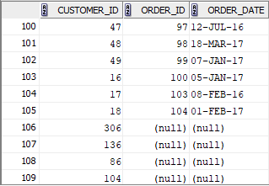
LEFT / RIGHT OUTER JOIN
LEFT (or RIGHT) JOIN returns
The result of the inner join between two tables (all matched rows)
And any unmatched rows from the left (or right) tables
Display all customers and their orders. Include the customers without orders in your result.
SELECT c.customer_id, o.order_id, o.order_date
FROM ass_customers c
LEFT OUTER JOIN ass_orders o
ON c.customer_id = o.customer_id;
…
…

Slide 37
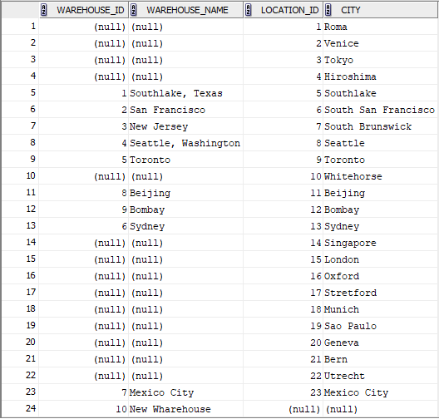
FULL OUTER JOIN
LEFT (or RIGHT) JOIN returns
The result of the inner join between two tables (all matched rows)
And any non-matching rows from both left and right tables
SELECT w.warehouse_id,
w.warehouse_name,
l.location_id
FROM ass_warehouses w
FULL OUTER JOIN ass_locations l
ON w.location_id = l.location_id;

Slide 38
EQUIJOIN

Slide 39
NATURAL JOIN

Slide 40
NATURAL JOIN with USING

